Slide 1
Evan Leybourn
STARTING WITH VSM & KANBAN
A practical workshop on value stream mapping & WIP
 | Starting with Value Stream Mapping and Kanban by Evan Leybourn is licensed under a Creative Commons Attribution-ShareAlike 3.0 Australia License <http://creativecommons.org/licenses/by-sa/3.0/au/>

Slide 2
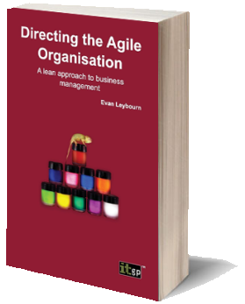
Evan Leybourn lean / agile business leader and author
Singapore
@eleybourn http://theagiledirector.com
CLICK TO DISCOVER MORE

Slide 3
waterfall
To what degree is the outcome knowable in advance?
agile
To what degree is the outcome dependent on intangible elements?
To what degree can you coordinate and control all the players?

Slide 4
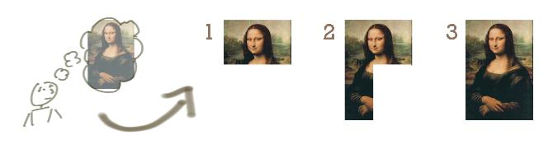
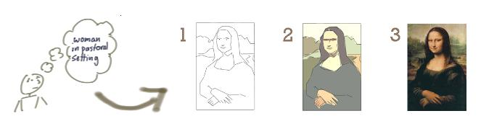
Waterfall (Incrementing)
Agile (Iterating)
Images with thanks from Jeff Patton: http://www.agileproductdesign.com/

Slide 5
individuals and interactions over processes and tools

Slide 6
working software over comprehensive documentation

Slide 7
customer collaboration over contract negotiation

Slide 8
responding to change over following a plan

Slide 9
1. eliminate waste
2. amplify learning
3. decide as late as possible
4. deliver as fast as possible
5. empower the team
6. build integrity in
7. see the whole

Slide 10
mura: unevenness muri: overburden muda: waste understanding waste

Slide 11
the 7 wastes transport inventory motion waiting overproduction over processing defects

Slide 12
agile business intelligence part 2: flow

Slide 13
Backlog
Build
Test
Done

Slide 14
Backlog
Build
Test
Done
Analysis
Stage
Doc’
Release

Slide 15
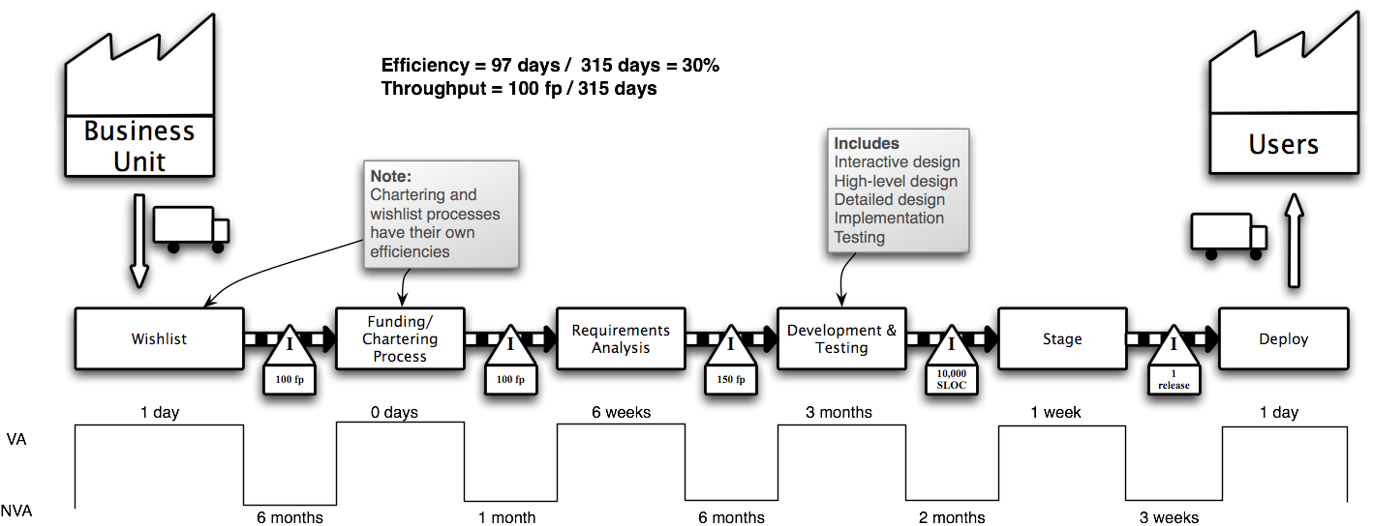

Slide 16
value stream mapping defines the ‘as-is’ steps & roles for each task

Slide 17
value add (va) time spent on outcomes for the customer

Slide 18
non-value add (nva) time spent between steps

Slide 19
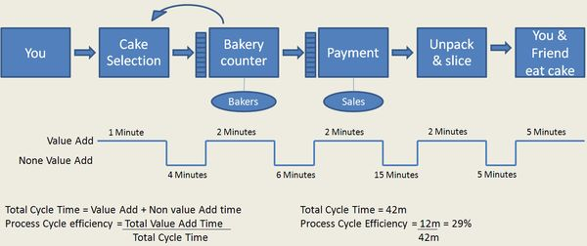

Slide 20
1. gather preliminary information
2. product quantity routing analysis
3. group customers and materials
4. sort product families by sequence
5. choose one value stream to start

Slide 21
6. create an operations flow chart
7. walk the shop floor
8. collect the data
9. construct the vsm
10. summarize the data to get the big picture

Slide 22
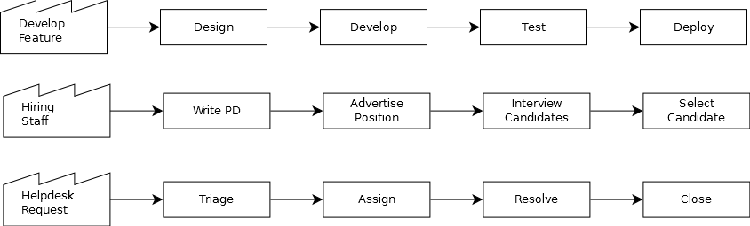
identify, isolate and define the process

Slide 23
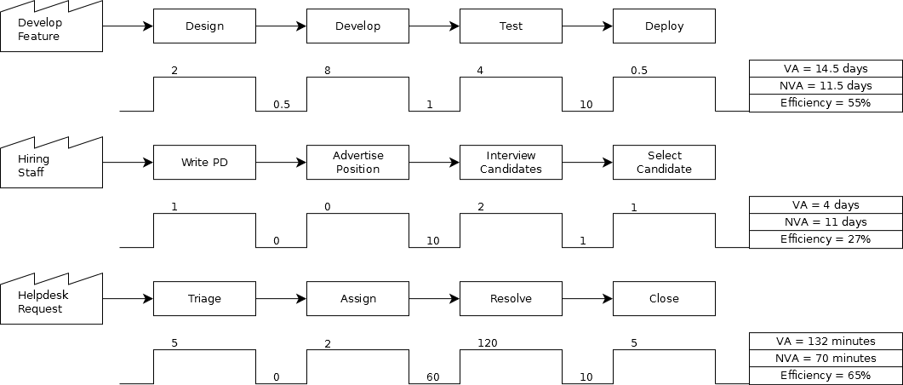
measure the average va and nva

Slide 24
calculate your process efficiency
= (va / va + nva)

Slide 25
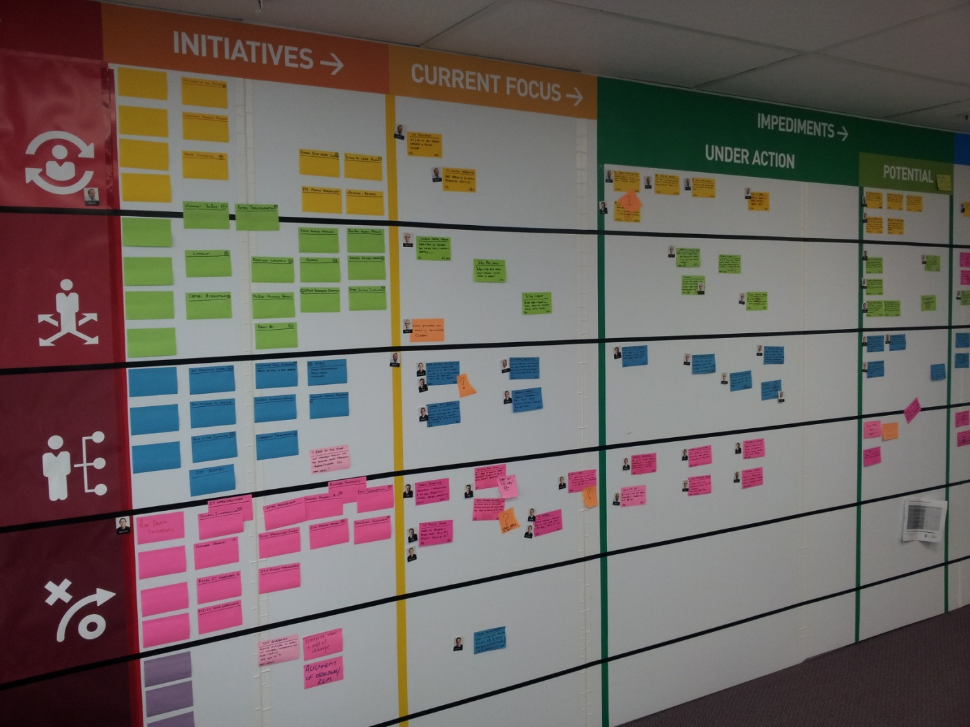
what is kanban (かんばん) workflow monitoring & visualisation

Slide 26

1. visualise (card wall)
2. limit wip
3. manage flow
4. make policies explicit
5. feedback loops
6. improve collaboratively

Slide 27
kanbanify your vsm
- merge 0’s
- define board policies
- calculate wip

Slide 28
work in progress limit concurrent work and promote workflow

Slide 29
min throughput is usually = team size if your efficiency was 100%, how many “x” could you do simultaneously?

Slide 30
what is your total wip total wip = min throughput / efficiency e.g. 7/55% ~= 13
Assuming a software team a 7 (not pairing)

Slide 31
calculate % effort per state
% effort = state va / total va e.g. 4 / 14.5 ~= 28%

Slide 32
proportion wip by state wip = total wip * % effort e.g. 13 * 28% ~= 4

Slide 33
proportion wip by state design wip = 2 develop wip = 7 test wip = 4 deploy wip = 0 = 1

Slide 34
“pull” all ready tasks to wip limit pull

Slide 35
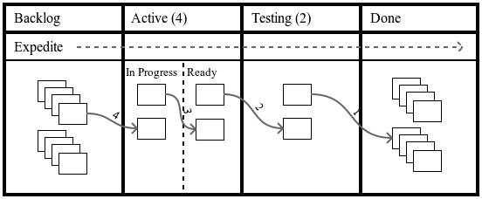

Slide 36
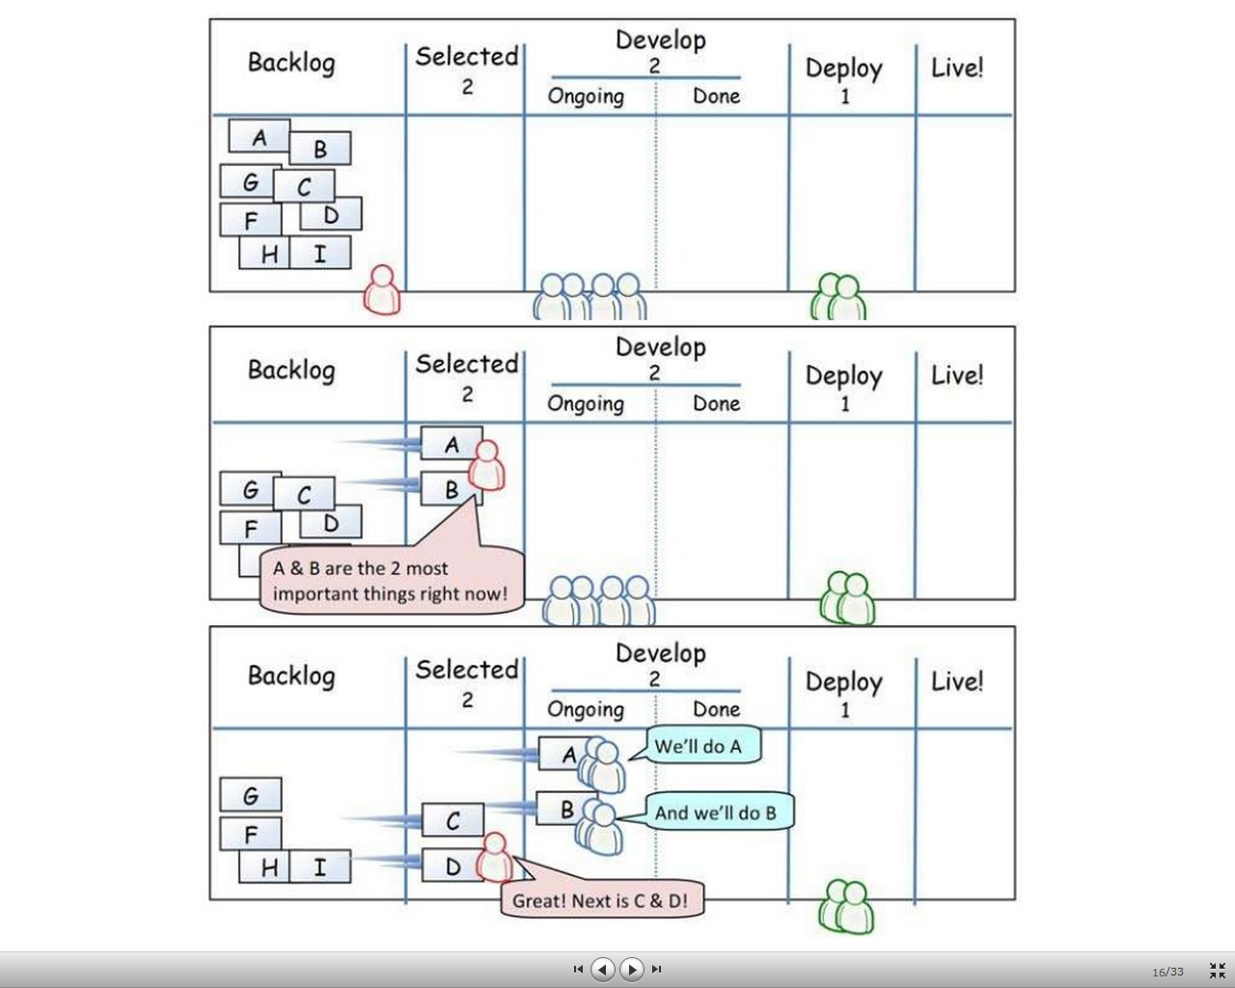

Slide 37
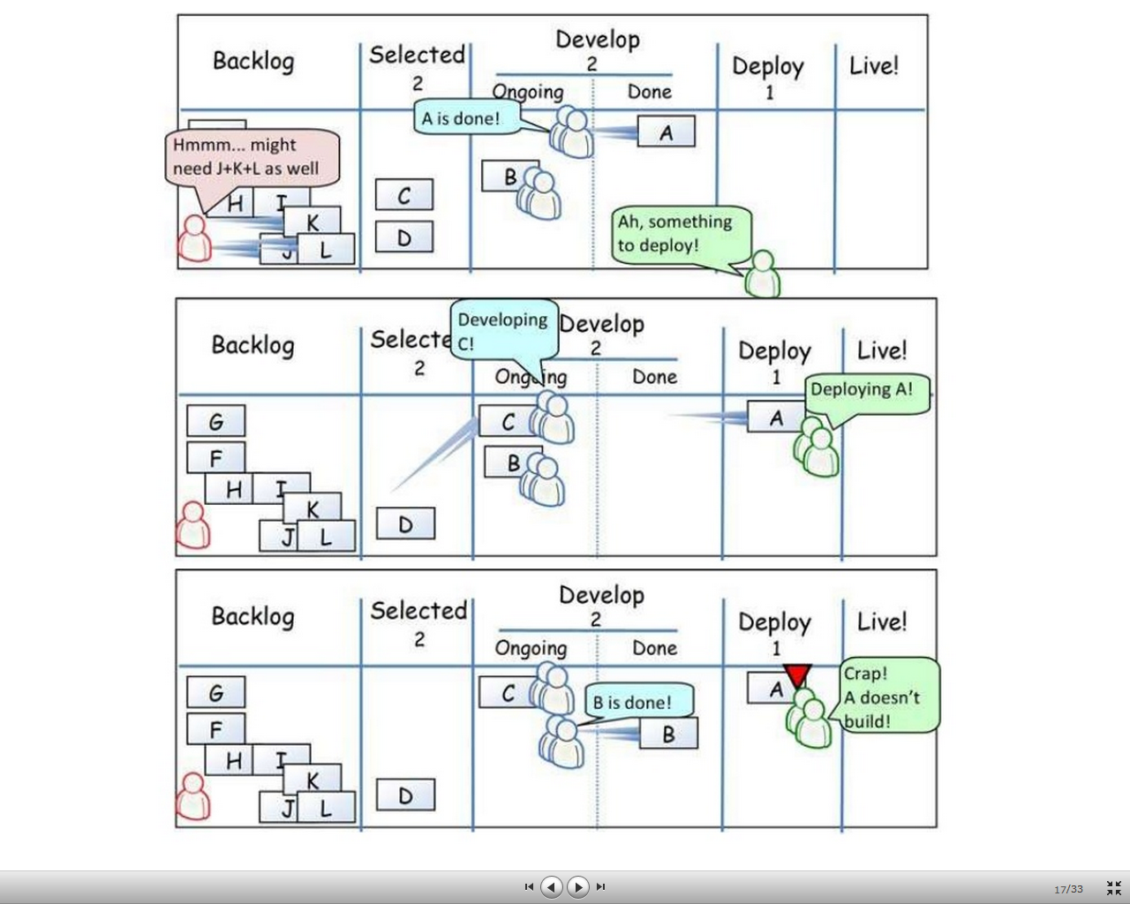

Slide 38
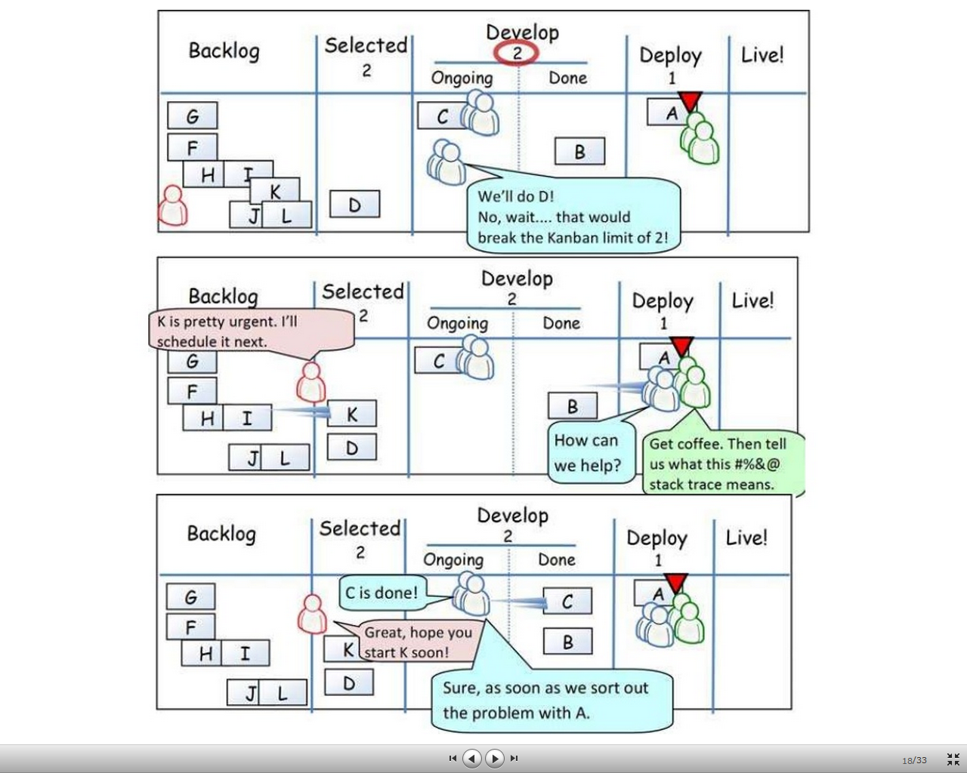

Slide 39
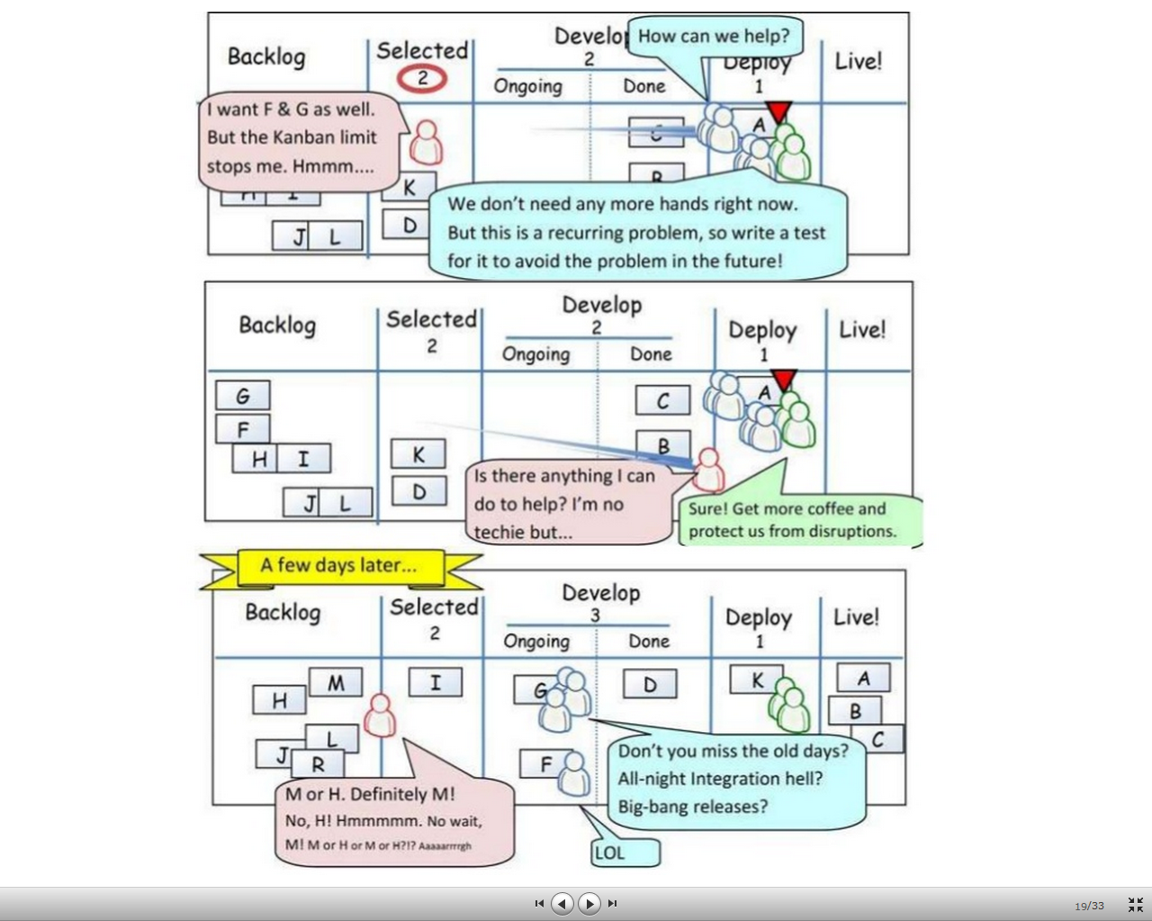

Slide 40
class of service expedite fixed delivery intangible class

Slide 41
tasks with upstream dependencies blocked

Slide 42
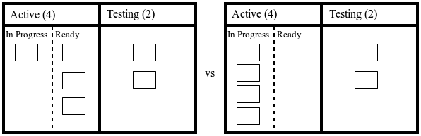

Slide 43
identify & resolve bottlenecks through low wip limits and strict process flow

Slide 44
production levelling constant rate of flow through all states

Slide 45
cycle time average time to complete a task from start

Slide 46
lead time average time to complete a task from request

Slide 47
progress monitoring cumulative flow diagram statistical run chart burndown/up chart

Slide 48
plot delivered functionality against duration effort visualisation

Slide 49
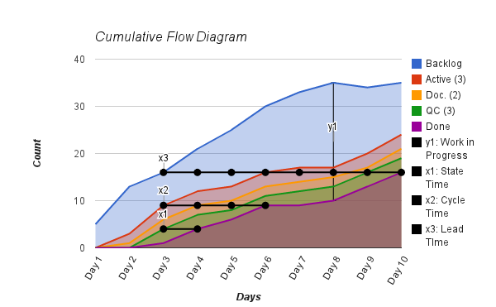
cumulative flow diagram

Slide 50
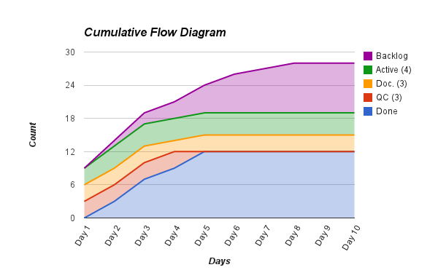
bottleneck

Slide 51
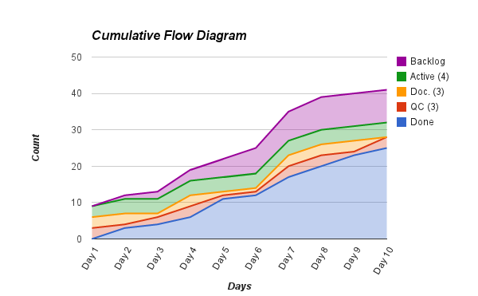
poor flow

Slide 52
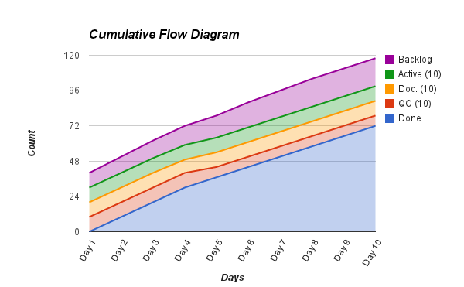
large wip

Slide 53
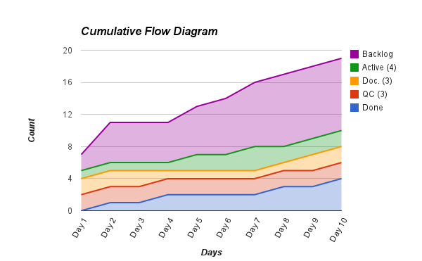
long lead time

Slide 54
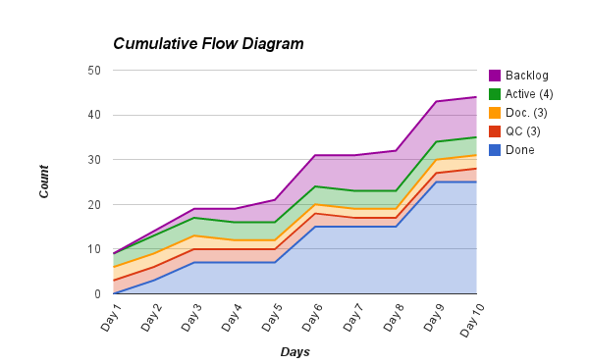
plateau

Slide 55
plot cycle time against average duration visualisation

Slide 56
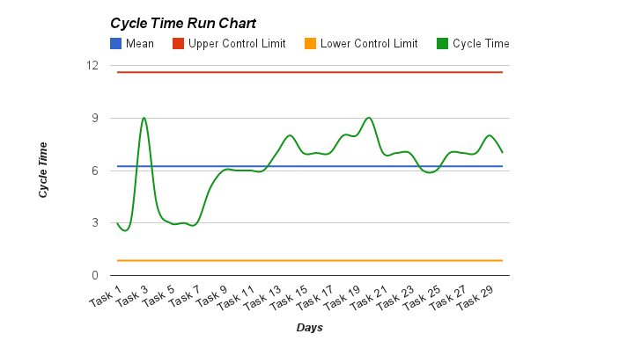
cycle time run charts

Slide 57
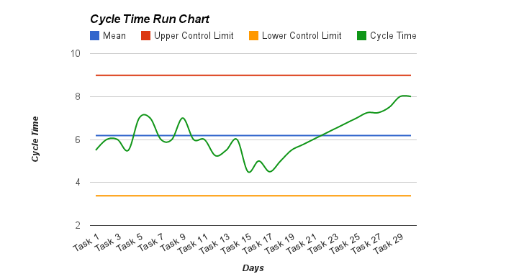
process trend

Slide 58
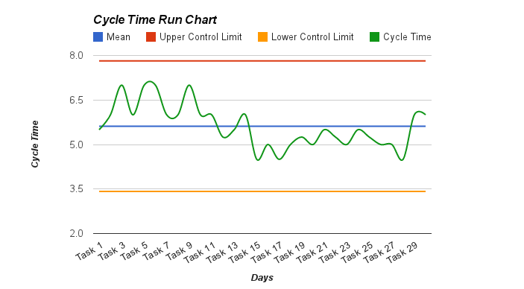
process shift

Slide 59
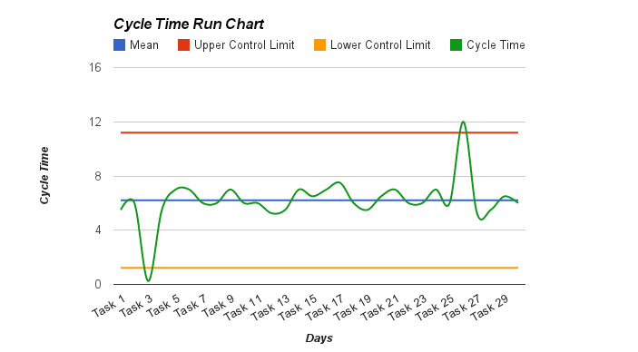
extreme process variation

Slide 60
effort visualisation plot delivered functionality against velocity

Slide 61
velocity how much work can be delivered per iteration

Slide 62
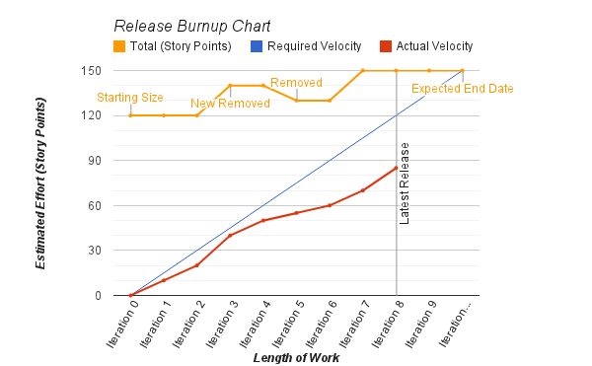
burnup chart

Slide 63
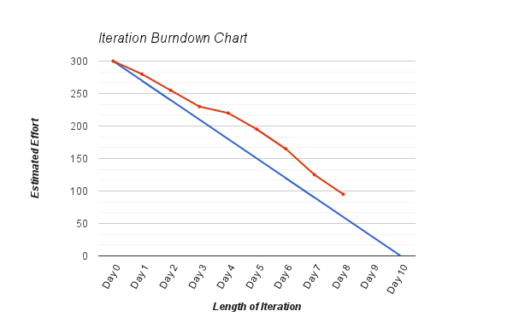
burndown chart

Slide 64
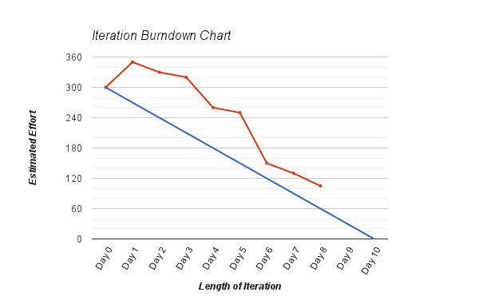
discovery

Slide 65
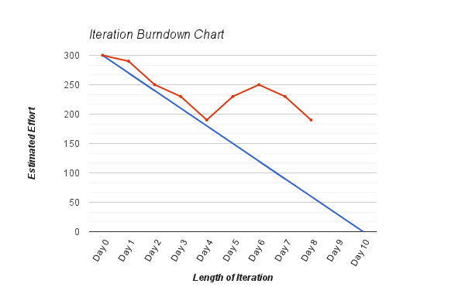
scope creep

Slide 66
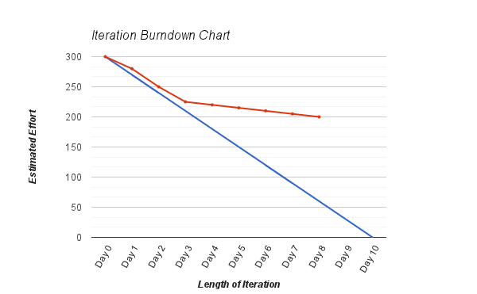
plateau

Slide 67
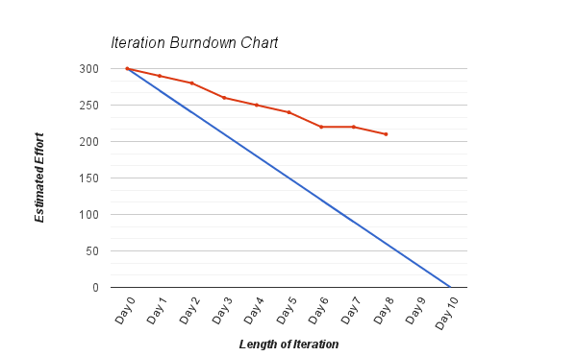
too many features

Slide 68
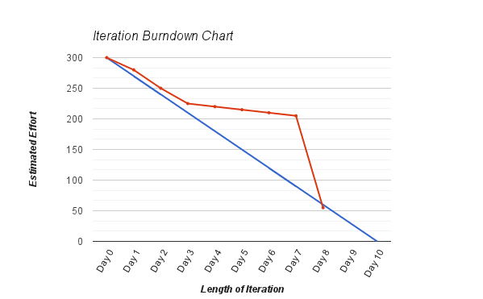
tracking epics

Slide 69
inspect and adapt kaizen (改善)

Slide 70
what went well? retrospective / quality circle

Slide 71
add actionable tasks to the backlog what could be improved?

Slide 72
kaizen emphasises teamwork, discipline & morale

Slide 73
1. do not send defective products to the subsequent process
2. the subsequent process comes to withdraw only what is needed
3. produce only the exact quantity withdrawn by the subsequent process
4. equalise, or level, the production
5. kanban is a means to fine tuning
6. stabilize and rationalize the process

Slide 74

http://agilebusinessmanagement.org
- Case Studies
- Articles
- Community
Join our Agile Journey
Notes:
Let’s finish off by looking at our original definition of business growth; Business growth comes from applying profitability to customer growth. Profitability comes from delivering services to your customers, accurately and efficiently. Over the last 15 minutes we have looked at some of the mechanisms from the lean and agile traditions that we can apply for adaptable businesses and sustainable business growth.
And I’ll leave you on that note. Any questions.

Slide 75
To learn more, check out
Directing the Agile Organisation by Evan Leybourn available at Amazon and all good book stores
CLICK TO DISCOVER MORE

